Slide 1
CHAPTER 5
Trees
All the programs in this file are selected from
Ellis Horowitz, Sartaj Sahni, and Susan Anderson-Freed
“Fundamentals of Data Structures in C”,
Computer Science Press, 1992.

Slide 2
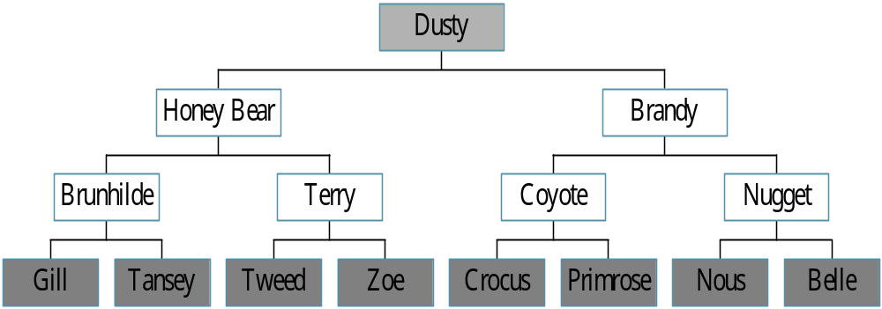
Trees
Root
leaf

Slide 3
Definition of Tree
A tree is a finite set of one or more nodes
such that:
There is a specially designated node called
the root.
The remaining nodes are partitioned into n>=0 disjoint sets T1, ..., Tn, where each of these sets is a tree.
We call T1, ..., Tn the subtrees of the root.

Slide 4
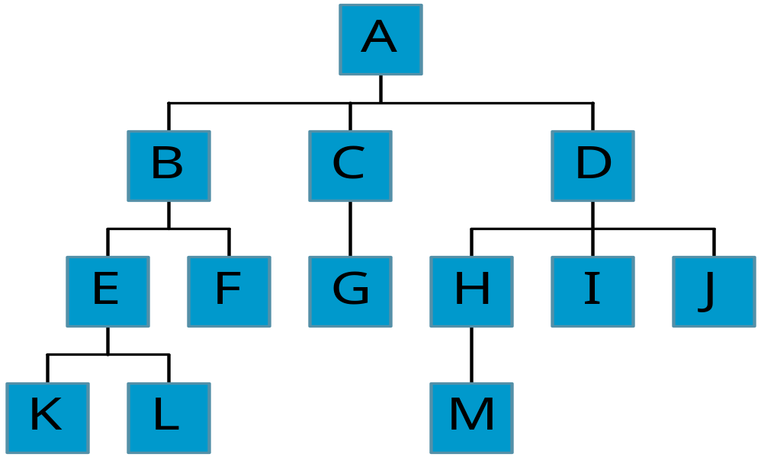
Level and Depth
Level
1
2
3
4
node (13)
degree of a node
leaf (terminal)
nonterminal
parent
children
sibling
degree of a tree (3)
ancestor
level of a node
height of a tree (4)
3
1
2
2
1
2
3
2
2
3
3
3
3
0
1
3
3
0
0
0
0
4
0
4
0
4

Slide 5
Terminology
The degree of a node is the number of subtrees
of the node
  The degree of A is 3; the degree of C is 1.
The node with degree 0 is a leaf or terminal
node.
A node that has subtrees is the parent of the
roots of the subtrees.
The roots of these subtrees are the children of
the node.
Children of the same parent are siblings.
The ancestors of a node are all the nodes
along the path from the root to the node.

Slide 6
Representation of Trees
List Representation
  ( A ( B ( E ( K, L ), F ), C ( G ), D ( H ( M ), I, J ) ) )
  The root comes first, followed by a list of sub-trees
data
link 1
link 2
...
link n
How many link fields are
needed in such a representation?

Slide 7
Left Child - Right Sibling
data
A
left child
right sibling
B
C
D
E
F
G
H
I
J
K
L
M

Slide 8
Binary Trees
A binary tree is a finite set of nodes that is
either empty or consists of a root and two
disjoint binary trees called the left subtree
and the right subtree.
Any tree can be transformed into binary tree.
  by left child-right sibling representation
The left subtree and the right subtree are distinguished.

Slide 9
*Figure 5.6: Left child-right child tree representation of a tree (p.191)
A
B
E
C
G
D
K
F
H
L
M
I
J

Slide 10
Abstract Data Type Binary_Tree
structure Binary_Tree(abbreviated BinTree) is
objects: a finite set of nodes either empty or
consisting of a root node, left Binary_Tree,
and right Binary_Tree.
functions:
for all bt, bt1, bt2 ∈ BinTree, item ∈ element
Bintree Create()::= creates an empty binary tree
Boolean IsEmpty(bt)::= if (bt==empty binary
tree) return TRUE else return FALSE

Slide 11
BinTree MakeBT(bt1, item, bt2)::= return a binary tree
whose left subtree is bt1, whose right subtree is bt2,
and whose root node contains the data item
Bintree Lchild(bt)::= if (IsEmpty(bt)) return error
else return the left subtree of bt
element Data(bt)::= if (IsEmpty(bt)) return error
else return the data in the root node of bt
Bintree Rchild(bt)::= if (IsEmpty(bt)) return error
else return the right subtree of bt

Slide 12
Samples of Trees
Complete Binary Tree
A
A
1
A
B
B
2
B
C
C
Skewed Binary Tree
3
D
E
F
G
D
4
H
I
E
5

Slide 13
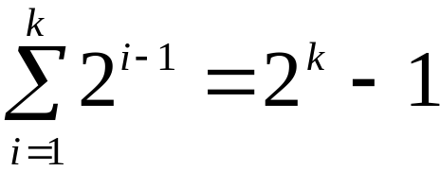
Maximum Number of Nodes in BT
The maximum number of nodes on level i of a binary tree is 2^{i-1}, i>=1.
The maximum nubmer of nodes in a binary tree
of depth k is 2^{k}-1, k>=1.
i-1
Prove by induction.

Slide 14
Relations between Number of
Leaf Nodes and Nodes of Degree 2
For any nonempty binary tree, T, if n0 is the
number of leaf nodes and n2 the number of nodes
of degree 2, then n0=n2+1
proof:
Let n and B denote the total number of nodes &
branches in T.
Let n0, n1, n2 represent the nodes with no children,
single child, and two children respectively.
n= n0+n1+n2, B+1=n, B=n1+2n2 ==> n1+2n2+1= n,
n1+2n2+1= n0+n1+n2 ==> n0=n2+1

Slide 15
Full BT VS Complete BT
A full binary tree of depth k is a binary tree of
depth k having 2 -1 nodes, k>=0.
A binary tree with n nodes and depth k is
complete iff its nodes correspond to the nodes numbered from 1 to n in the full binary tree of
depth k.
k
由上至下，
由左至右編號
A
A
B
C
B
C
D
E
F
G
D
E
F
G
H
H
I
J
K
L
M
N
O
I
Complete binary tree
Full binary tree of depth 4

Slide 16
Binary Tree Representations
If a complete binary tree with n nodes (depth =
log n + 1) is represented sequentially, then for
any node with index i, 1<=i<=n, we have:
  parent(i) is at i/2 if i!=1. If i=1, i is at the root and
  has no parent.
  left_child(i) ia at 2i if 2i<=n. If 2i>n, then i has no
  left child.
  right_child(i) ia at 2i+1 if 2i +1 <=n. If 2i +1 >n,
  then i has no right child.

Slide 17
Sequential Representation
[1]
[2]
[3]
[4]
[5]
[6]
[7]
[8]
[9]
A
B
C
D
E
F
G
H
I
(1) waste space
(2) insertion/deletion
problem
A
[1]
[2]
[3]
[4]
[5]
[6]
[7]
[8]
[9]
.
[16]
A
B
--
C
--
--
--
D
--
.
E
B
A
C
B
C
D
D
E
F
G
E
H
I

Slide 18
Linked Representation
typedef struct node *tree_pointer;
typedef struct node {
int data;
tree_pointer left_child, right_child;
};
data
left_child
data
right_child
left_child
right_child

Slide 19
Binary Tree Traversals
Let L, V, and R stand for moving left, visiting
the node, and moving right.
There are six possible combinations of traversal
  LVR, LRV, VLR, VRL, RVL, RLV
Adopt convention that we traverse left before
right, only 3 traversals remain
  LVR, LRV, VLR
  inorder, postorder, preorder

Slide 20
Arithmetic Expression Using BT
+
inorder traversal
A / B * C * D + E
infix expression
preorder traversal
+ * * / A B C D E
prefix expression
postorder traversal
A B / C * D * E +
postfix expression
level order traversal
+ * E * D / C A B
*
E
*
D
/
C
A
B

Slide 21
Inorder Traversal (recursive version)
void inorder(tree_pointer ptr)
/* inorder tree traversal */
{
if (ptr) {
inorder(ptr->left_child);
printf(“%d”, ptr->data);
indorder(ptr->right_child);
}
}
A / B * C * D + E

Slide 22
Preorder Traversal (recursive version)
void preorder(tree_pointer ptr)
/* preorder tree traversal */
{
if (ptr) {
printf(“%d”, ptr->data);
preorder(ptr->left_child);
predorder(ptr->right_child);
}
}
+ * * / A B C D E

Slide 23
Postorder Traversal (recursive version)
void postorder(tree_pointer ptr)
/* postorder tree traversal */
{
if (ptr) {
postorder(ptr->left_child);
postdorder(ptr->right_child);
printf(“%d”, ptr->data);
}
}
A B / C * D * E +

Slide 24
Iterative Inorder Traversal
(using stack)
void iter_inorder(tree_pointer node)
{
int top= -1; /* initialize stack */
tree_pointer stack[MAX_STACK_SIZE];
for (;;) {
for (; node; node=node->left_child)
add(&top, node);/* add to stack */
node= delete(&top);
/* delete from stack */
if (!node) break; /* empty stack */
printf(“%D”, node->data);
node = node->right_child;
}
}
O(n)

Slide 25
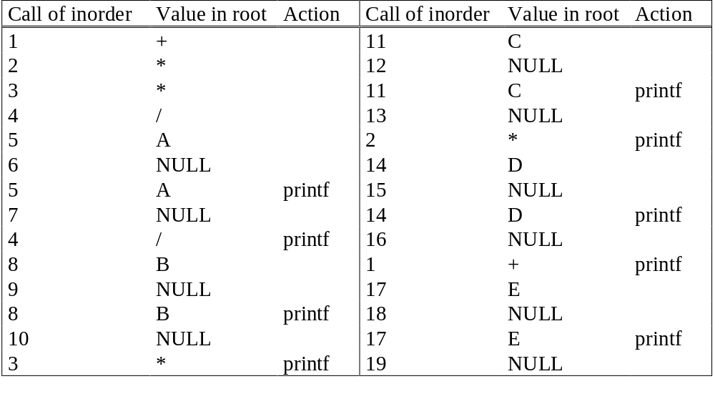
Trace Operations of Inorder Traversal

Slide 26
Level Order Traversal
(using queue)
void level_order(tree_pointer ptr)
/* level order tree traversal */
{
int front = rear = 0;
tree_pointer queue[MAX_QUEUE_SIZE];
if (!ptr) return; /* empty queue */
addq(front, &rear, ptr);
for (;;) {
ptr = deleteq(&front, rear);

Slide 27
if (ptr) {
printf(“%d”, ptr->data);
if (ptr->left_child)
addq(front, &rear,
ptr->left_child);
if (ptr->right_child)
addq(front, &rear,
ptr->right_child);
}
else break;
}
}
+ * E * D / C A B

Slide 28
Copying Binary Trees
tree_poointer copy(tree_pointer original)
{
tree_pointer temp;
if (original) {
temp=(tree_pointer) malloc(sizeof(node));
if (IS_FULL(temp)) {
fprintf(stderr, “the memory is full\n”);
exit(1);
}
temp->left_child=copy(original->left_child);
temp->right_child=copy(original->right_child);
temp->data=original->data;
return temp;
}
return NULL;
}
postorder

Slide 29
Equality of Binary Trees
the same topology and data
int equal(tree_pointer first, tree_pointer second)
{
/* function returns FALSE if the binary trees first and
second are not equal, otherwise it returns TRUE */
return ((!first && !second) || (first && second &&
(first->data == second->data) &&
equal(first->left_child, second->left_child) &&
equal(first->right_child, second->right_child)))
}

Slide 30
Propositional Calculus Expression
A variable is an expression.
If x and y are expressions, then ¬x, x∧y,
x∨y are expressions.
Parentheses can be used to alter the normal order of evaluation (¬ > ∧ > ∨).
Example: x₁ ∨ (x₂ ∧ ¬x₃)
satisfiability problem: Is there an assignment to make an expression true?

Slide 31
(x₁ ∧ ¬x₂) ∨ (¬ x₁ ∧ x₃) ∨ ¬x₃
(t,t,t)
(t,t,f)
(t,f,t)
(t,f,f)
(f,t,t)
(f,t,f)
(f,f,t)
(f,f,f)
2^{n} possible combinations
for n variables
∨
∨
¬
∧
∧
X₃
X₁
¬
¬
X₃
X₂
X₁
postorder traversal (postfix evaluation)

Slide 32
node structure
left_child data value right_child
typedef emun {not, and, or, true, false } logical;
typedef struct node *tree_pointer;
typedef struct node {
tree_pointer list_child;
logical data;
short int value;
tree_pointer right_child;
} ;

Slide 33
for (all 2^{n} possible combinations) { generate the next combination; replace the variables by their values; evaluate root by traversing it in postorder; if (root->value) { printf(<combination>); return;
}
} printf(“No satisfiable combination \n”);
First version of satisfiability algorithm

Slide 34
void post_order_eval(tree_pointer node)
{
/* modified post order traversal to evaluate a propositional calculus tree */ if (node) { post_order_eval(node->left_child); post_order_eval(node->right_child); switch(node->data) { case not: node->value =
!node->right_child->value; break;
Post-order-eval function

Slide 35
case and: node->value = node->right_child->value && node->left_child->value; break; case or: node->value = node->right_child->value | | node->left_child->value; break; case true: node->value = TRUE; break; case false: node->value = FALSE;
}
}
}

Slide 36
Threaded Binary Trees
Two many null pointers in current representation
of binary trees
n: number of nodes
number of non-null links: n-1
total links: 2n
null links: 2n-(n-1)=n+1
Replace these null pointers with some useful “threads”.

Slide 37
Threaded Binary Trees (Continued)
If ptr->left_child is null,
replace it with a pointer to the node that would be
visited before ptr in an inorder traversal
If ptr->right_child is null,
replace it with a pointer to the node that would be
visited after ptr in an inorder traversal

Slide 38
A Threaded Binary Tree
root
A
dangling
B
C
dangling
D
E
F
G
inorder traversal:
H, D, I, B, E, A, F, C, G
H
I

Slide 39
Data Structures for Threaded BT
left_thread left_child data right_child right_thread
TRUE
●
●
FALSE
TRUE: thread
FALSE: child
typedef struct threaded_tree *threaded_pointer;
typedef struct threaded_tree {
short int left_thread;
threaded_pointer left_child;
char data;
threaded_pointer right_child;
short int right_thread; };

Slide 40
Memory Representation of A Threaded BT
root
--
f
f
f
A
f
f
B
f
f
C
f
f
D
f
t
E
t
t
F
t
t
G
t
t
H
t
t
I
t

Slide 41
Next Node in Threaded BT
threaded_pointer insucc(threaded_pointer tree)
{
threaded_pointer temp;
temp = tree->right_child;
if (!tree->right_thread)
while (!temp->left_thread)
temp = temp->left_child;
return temp;
}

Slide 42
Inorder Traversal of Threaded BT
void tinorder(threaded_pointer tree)
{
/* traverse the threaded binary tree inorder */
threaded_pointer temp = tree;
for (;;) {
temp = insucc(temp);
if (temp==tree) break;
printf(“%3c”, temp->data);
}
}
O(n)

Slide 43
Inserting Nodes into Threaded BTs
Insert child as the right child of node parent
  change parent->right_thread to FALSE
  set child->left_thread and child->right_thread to TRUE
  set child->left_child to point to parent
  set child->right_child to parent->right_child
  change parent->right_child to point to child

Slide 44
Examples
Insert a node D as a right child of B.
root
root
A
A
(1)
B
parent
B
parent
(3)
child
child
C
D
C
D
(2)
empty

Slide 45
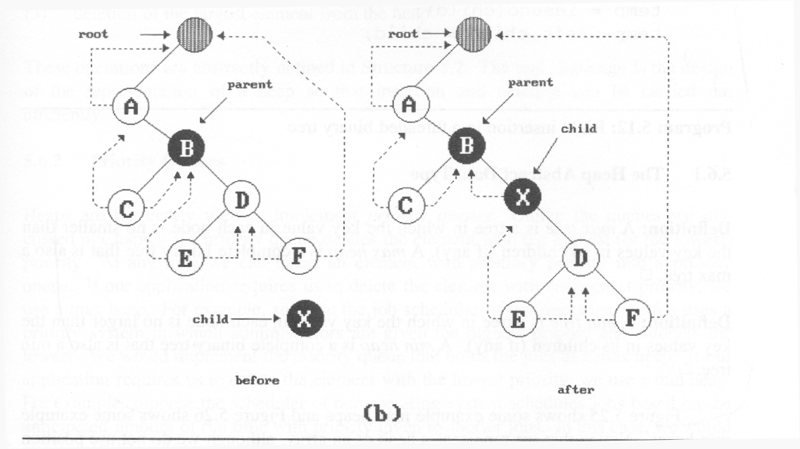
*Figure 5.24: Insertion of child as a right child of parent in a threaded binary tree (p.217)
(3)
(2)
(1)
(4)
nonempty

Slide 46
Right Insertion in Threaded BTs
void insert_right(threaded_pointer parent,
threaded_pointer child)
{
threaded_pointer temp;
child->right_child = parent->right_child;
child->right_thread = parent->right_thread;
child->left_child = parent; case (a)
child->left_thread = TRUE;
parent->right_child = child;
parent->right_thread = FALSE;
if (!child->right_thread) { case (b)
temp = insucc(child);
temp->left_child = child;
}
}
(1)
(2)
(3)
(4)

Slide 47
Heap
A max tree is a tree in which the key value in
each node is no smaller than the key values in
its children. A max heap is a complete binary
tree that is also a max tree.
A min tree is a tree in which the key value in
each node is no larger than the key values in
its children. A min heap is a complete binary
tree that is also a min tree.
Operations on heaps
  creation of an empty heap
  insertion of a new element into the heap;
  deletion of the largest element from the heap

Slide 48
*Figure 5.25: Sample max heaps (p.219)
[1]
14
[1]
9
[1]
30
[2]
12
[3]
7
[2]
6
[3]
3
[2]
25
[4]
[5]
[6]
[4]
10
8
6
5
Property:
The root of max heap (min heap) contains
the largest (smallest).

Slide 49
*Figure 5.26:Sample min heaps (p.220)
[1]
2
[1]
10
[1]
11
[2]
7
[3]
4
[2]
20
[3]
83
[2]
21
[4]
[5]
[6]
[4]
10
8
6
50

Slide 50
ADT for Max Heap
structure MaxHeap
objects: a complete binary tree of n > 0 elements organized so that
the value in each node is at least as large as those in its children
functions:
for all heap belong to MaxHeap, item belong to Element, n,
max_size belong to integer
MaxHeap Create(max_size)::= create an empty heap that can
hold a maximum of max_size elements
Boolean HeapFull(heap, n)::= if (n==max_size) return TRUE
else return FALSE
MaxHeap Insert(heap, item, n)::= if (!HeapFull(heap,n)) insert
item into heap and return the resulting heap
else return error
Boolean HeapEmpty(heap, n)::= if (n>0) return FALSE
else return TRUE
Element Delete(heap,n)::= if (!HeapEmpty(heap,n)) return one
instance of the largest element in the heap
and remove it from the heap
else return error

Slide 51
Application: priority queue
machine service
  amount of time (min heap)
  amount of payment (max heap)
factory
  time tag

Slide 52
Data Structures
unordered linked list
unordered array
sorted linked list
sorted array
heap

Slide 53
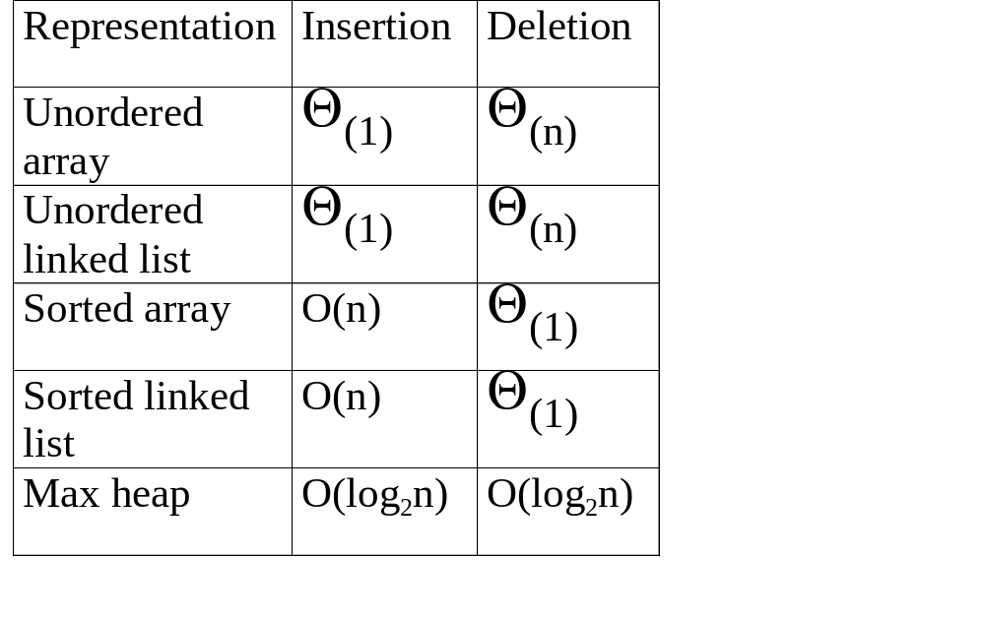
*Figure 5.27: Priority queue representations (p.221)

Slide 54
Example of Insertion to Max Heap
20
20
21
15
2
15
5
15
20
14
10
14
10
2
14
10
2
initial location of new node
insert 5 into heap
insert 21 into heap

Slide 55
Insertion into a Max Heap
void insert_max_heap(element item, int *n)
{
int i;
if (HEAP_FULL(*n)) {
fprintf(stderr, “the heap is full.\n”);
exit(1);
}
i = ++(*n);
while ((i!=1)&&(item.key>heap[i/2].key)) {
heap[i] = heap[i/2];
i /= 2;
}
heap[i]= item;
}
2^{k}-1=n ==> k=⎡log₂(n+1)⎤
O(log₂n)

Slide 56
Example of Deletion from Max Heap
remove
20
10
15
15
2
15
2
14
2
14
10
14
10

Slide 57
Deletion from a Max Heap
element delete_max_heap(int *n)
{
int parent, child;
element item, temp;
if (HEAP_EMPTY(*n)) {
fprintf(stderr, “The heap is empty\n”);
exit(1);
}
/* save value of the element with the
highest key */
item = heap[1];
/* use last element in heap to adjust heap */
temp = heap[(*n)--];
parent = 1;
child = 2;

Slide 58
while (child <= *n) {
/* find the larger child of the current
parent */
if ((child < *n)&&
(heap[child].key<heap[child+1].key))
child++;
if (temp.key >= heap[child].key) break;
/* move to the next lower level */
heap[parent] = heap[child];
child *= 2;
}
heap[parent] = temp;
return item;
}

Slide 59
Binary Search Tree
Heap
  a min (max) element is deleted. O(log₂n)
  deletion of an arbitrary element O(n)
  search for an arbitrary element O(n)
Binary search tree
  Every element has a unique key.
  The keys in a nonempty left subtree (right subtree) are smaller (larger) than the key in the root of subtree.
  The left and right subtrees are also binary search trees.

Slide 60
Examples of Binary Search Trees
20
30
60
12
25
5
40
70
10
15
22
2
65
80

Slide 61
Searching a Binary Search Tree
tree_pointer search(tree_pointer root,
int key)
{
/* return a pointer to the node that contains key. If there is no such
node, return NULL */
if (!root) return NULL;
if (key == root->data) return root;
if (key < root->data)
return search(root->left_child,
key);
return search(root->right_child,key);
}

Slide 62
Another Searching Algorithm
tree_pointer search2(tree_pointer tree, int key)
{
while (tree) {
if (key == tree->data) return tree;
if (key < tree->data)
tree = tree->left_child;
else tree = tree->right_child;
}
return NULL;
}
O(h)

Slide 63
Insert Node in Binary Search Tree
30
30
30
40
5
40
5
40
5
2
80
2
35
80
2
Insert 80
Insert 35

Slide 64
Insertion into A Binary Search Tree
void insert_node(tree_pointer *node, int num)
{tree_pointer ptr,
temp = modified_search(*node, num);
if (temp || !(*node)) {
ptr = (tree_pointer) malloc(sizeof(node));
if (IS_FULL(ptr)) {
fprintf(stderr, “The memory is full\n”);
exit(1);
}
ptr->data = num;
ptr->left_child = ptr->right_child = NULL;
if (*node)
if (num<temp->data) temp->left_child=ptr;
else temp->right_child = ptr;
else *node = ptr;
}
}

Slide 65
Deletion for A Binary Search Tree
1
leaf
node
30
5
80
T2
T1
1
2
2
X
T1
T2

Slide 66
Deletion for A Binary Search Tree
non-leaf
node
40
40
20
60
20
55
10
30
50
70
10
30
50
70
45
55
45
52
52
Before deleting 60
After deleting 60

Slide 67
1
2
T1
T2
T3
1
2‘
T1
T2’
T3

Slide 68
Selection Trees
(1) winner tree
(2) loser tree

Slide 69
winner tree
sequential
allocation
scheme
(complete
binary
tree)
Each node represents
the smaller of its two
children.
1
6
2
3
6
8
4
5
6
7
9
6
8
17
8
9
10
11
12
13
14
15
10
9
20
6
8
9
90
17
ordered sequence
15
20
20
15
15
11
100
18
16
38
30
25
50
16
110
20
run 1
run 2
run 3
run 4
run 5
run 6
run 7
run 8

Slide 70
*Figure 5.35: Selection tree of Figure 5.34 after one record has been
output and the tree restructured(nodes that were changed are ticked)
1 
8
2 
3
9
8
4
5 
6
7
9
15
8
17
8
9
10
11
12
13
14
15
10
9
20
15
8
9
90
17
15
20
20
25
15
11
100
18
16
38
30
25
50
16
110
20

Slide 71
Analysis
K: # of runs
n: # of records
setup time: O(K) (K-1)
restructure time: O(log₂K) ⎡log₂(K+1)⎤
merge time: O(nlog₂K)
slight modification: tree of loser
  consider the parent node only (vs. sibling nodes)

Slide 72
*Figure 5.36: Tree of losers corresponding to Figure 5.34 (p.235)
overall
winner
6
8
9
1
8
9
2
3
9
15
17
4
5
6
7
10
20
15
9
90
8
9
10
11
12
13
14
15
10
9
20
6
8
9
90
17
Run 1 2 3 4 5 6 7 8
15
15

Slide 73
Forest
A forest is a set of n >= 0 disjoint trees
A
Forest
A
E
G
B
E
B
C
D
F
H
I
C
F
G
D
H
I

Slide 74
Transform a forest into a binary tree
T1, T2, …, Tn: a forest of trees
B(T1, T2, …, Tn): a binary tree corresponding to this forest
algorithm
(1) empty, if n = 0
(2) has root equal to root(T1)
has left subtree equal to B(T11,T12,…,T1m)
has right subtree equal to B(T2,T3,…,Tn)

Slide 75
Forest Traversals
Preorder
  If F is empty, then return
  Visit the root of the first tree of F
  Taverse the subtrees of the first tree in tree preorder
  Traverse the remaining trees of F in preorder
Inorder
  If F is empty, then return
  Traverse the subtrees of the first tree in tree inorder
  Visit the root of the first tree
  Traverse the remaining trees of F is indorer

Slide 76
A
inorder: EFBGCHIJDA
preorder: ABEFCGDHIJ
B
A
E
C
B
C
D
F
G
D
E
F
H
J
G
I
H
I
preorder
B
E
F
C
G
D
H
I
J
J

Slide 77
Set Representation
S1={0, 6, 7, 8}, S2={1, 4, 9}, S3={2, 3, 5}
Two operations considered here
  Disjoint set union S₁ ∪ S₂={0,6,7,8,1,4,9}
  Find(i): Find the set containing the element i.
  3 ∈ S₃, 8 ∈ S₁
0
1
2
6
7
8
4
9
3
5
S_{i} ∩ S_{j} = φ

Slide 78
Disjoint Set Union
Make one of trees a subtree of the other
0
1
8
1
0
4
9
6
7
4
9
6
7
8
Possible representation for S1 union S2

Slide 79
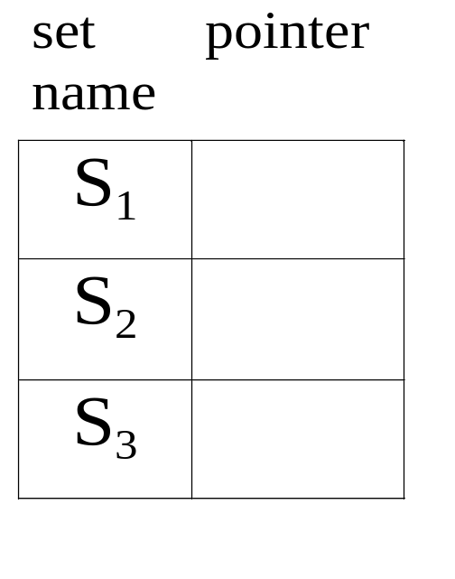
*Figure 5.41:Data Representation of S₁S₂and S₃ (p.240)
0
6
7
8
4
1
9
2
3
5

Slide 80
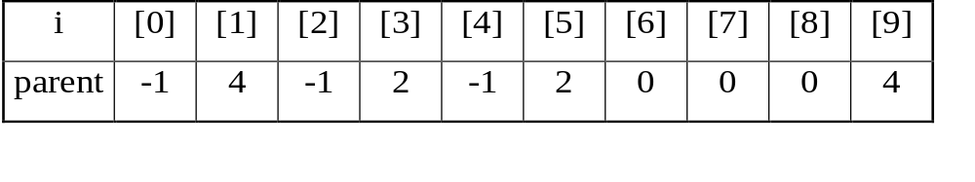
Array Representation for Set
int find1(int i)
{
for (; parent[i]>=0; i=parent[i]);
return i;
}
void union1(int i, int j)
{
parent[i]= j;
}

Slide 81
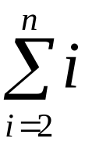
*Figure 5.43:Degenerate tree (p.242)
union operation
O(n) n-1
find operation
O(n²)
n-1
union(0,1), find(0)
union(1,2), find(0)
.
.
.
union(n-2,n-1),find(0)
n-2
•
•
•
0
degenerate tree

Slide 82
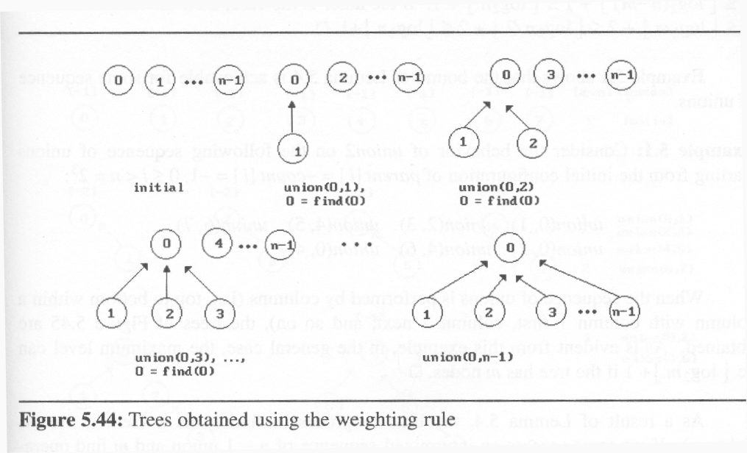
*Figure 5.44:Trees obtained using the weighting rule(p.243)
weighting rule for union(i,j): if # of nodes in i < # in j then j the parent of i

Slide 83
Modified Union Operation
void union2(int i, int j)
{
int temp = parent[i]+parent[j];
if (parent[i]>parent[j]) {
parent[i]=j;
parent[j]=temp;
}
else {
parent[j]=i;
parent[i]=temp;
}
}
Keep a count in the root of tree
i has fewer nodes.
j has fewer nodes
If the number of nodes in tree i is
less than the number in tree j, then
make j the parent of i; otherwise
make i the parent of j.

Slide 84
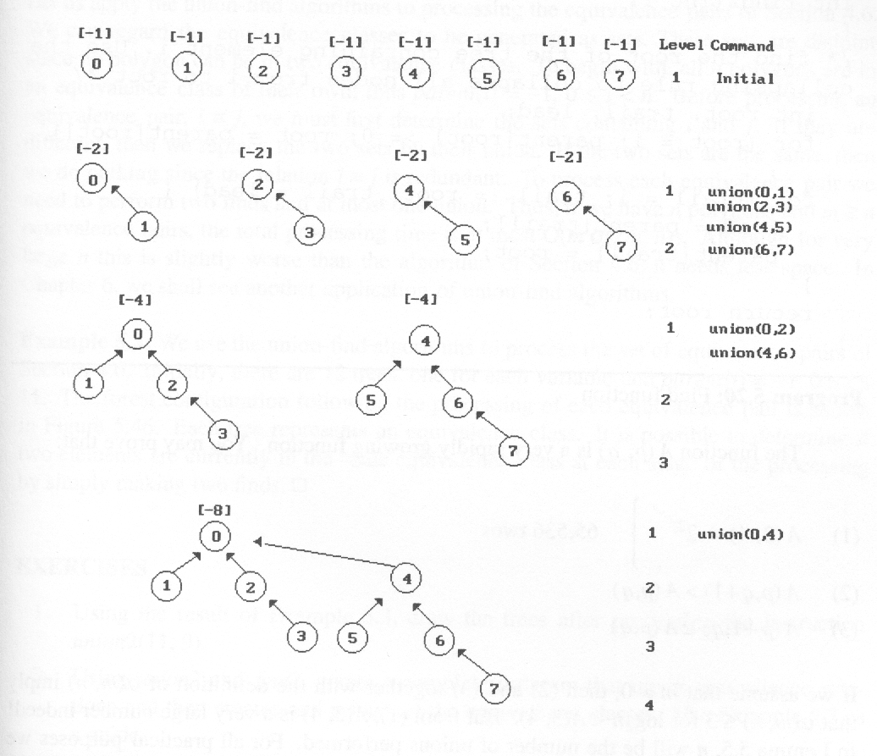
Figure 5.45:Trees achieving worst case bound (p.245)
⎣ log₂8⎦+1

Slide 85
Modified Find(i) Operation
int find2(int i)
{
int root, trail, lead;
for (root=i; parent[root]>=0;
root=parent[root]);
for (trail=i; trail!=root;
trail=lead) {
lead = parent[trail];
parent[trail]= root;
}
return root:
}
If j is a node on the path from
i to its root then make j a child
of the root

Slide 86
0
0
1
2
4
1
2
4
6
7
3
5
6
3
5
7
find(7) find(7) find(7) find(7) find(7) find(7) find(7) find(7)
go up 3 1 1 1 1 1 1 1
reset 2
12 moves (vs. 24 moves)

Slide 87
Applications
Find equivalence class i ≡ j
Find S_{i} and S_{j} such that i ∈ S_{i} and j ∈ S_{j}
(two finds)
  S_{i} = S_{j} do nothing
  S_{i} ≠ S_{j} union(S_{i} , S_{j})
example
0 ≡ 4, 3 ≡ 1, 6 ≡ 10, 8 ≡ 9, 7 ≡ 4, 6 ≡ 8,
3 ≡ 5, 2 ≡ 11, 11 ≡ 0
{0, 2, 4, 7, 11}, {1, 3, 5}, {6, 8, 9, 10}

Slide 88
preorder: A B C D E F G H I
inorder: B C A E D G H F I
A
A
D, E, F, G, H, I
B
D
B, C
A
C
E
F
B
D, E, F, G, H, I
G
I
C
H

